Slide 1
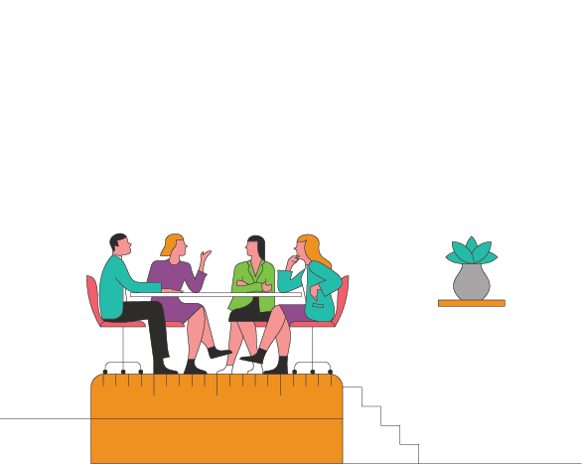
Team Communication Guide
Page 1.
What do we use synchronous communication for?
What do we use asynchronous communication for?
As a team, do we default to asynchronous or synchronous communication?
What does ‘urgent’ actually mean?
Which communication channels do we use for what types of communication?
Copyright © 2020 Inventium Toolbox Pty Ltd

Slide 2
What communication needs to happen daily/weekly/monthly and what is the best channel for it to happen in?
How will we ensure our synchronous discussions reflect equal contributions?
Based on team members’ chronotypes, when should we be doing synchronous vs asynchronous communication?
What are our key communication values?
(Remote teams) What are our planned rituals around in-person connection?
Copyright © 2020 Inventium Toolbox Pty Ltd

